Slide 1
Thermal analysis of polymers
Dr.Widad Salih
Polymer Chemistry
2023\2024

Slide 2
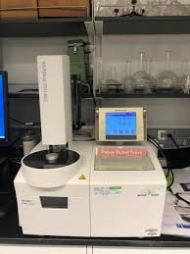
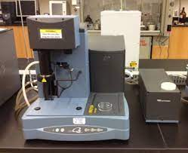
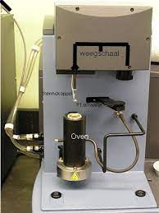
TGA-INSTRUMENTS

Slide 3
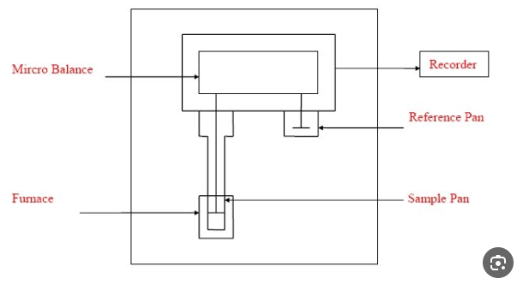
TGA -Components

Slide 4
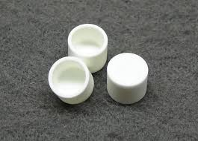
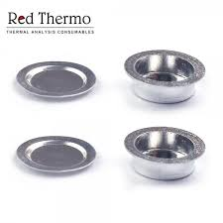
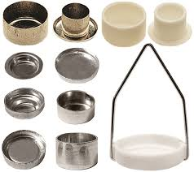
Sample pan
Alumina Pan (Al2O3 )
Aluminum Pan
Different Types of Pan

Slide 5
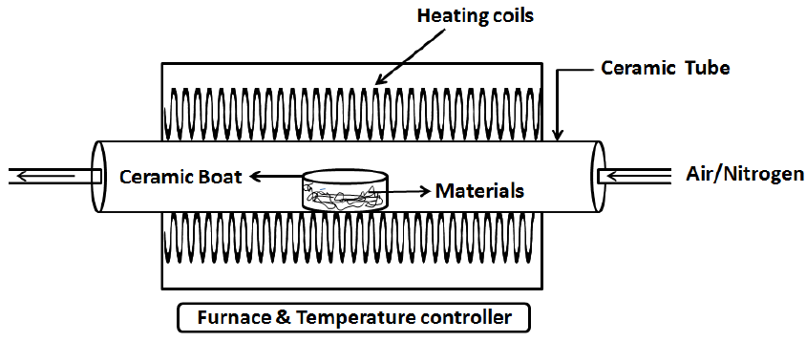
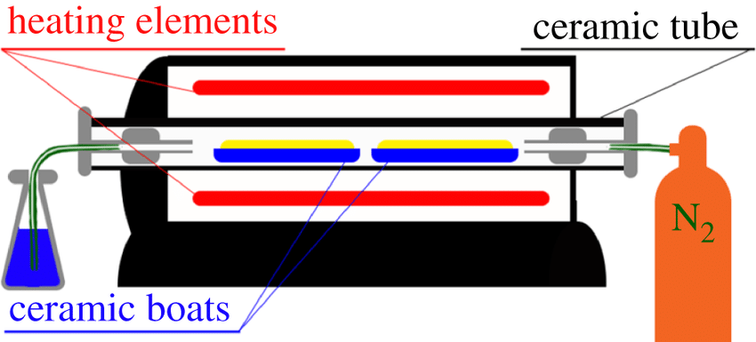
Tube furnace

Slide 6
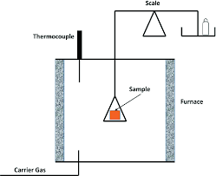
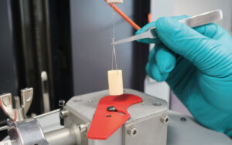
Thermobalance

Slide 7
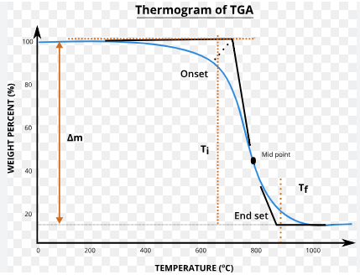
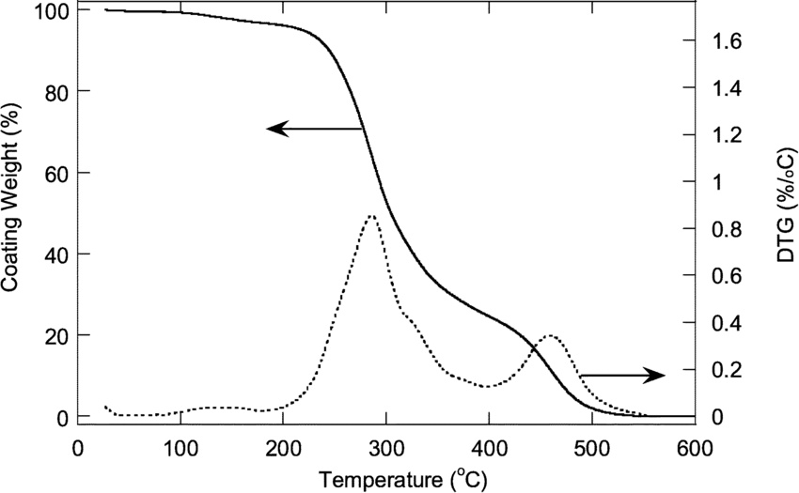
TGA THERMOGRAME

Slide 8
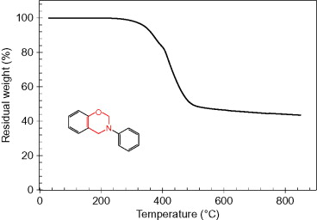
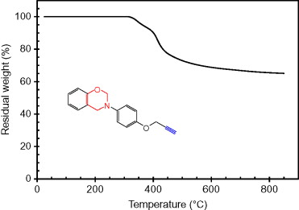
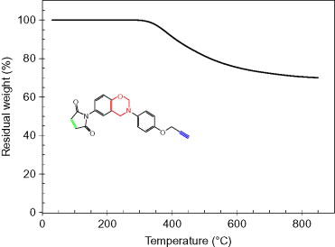
Tga thermograms

Slide 9
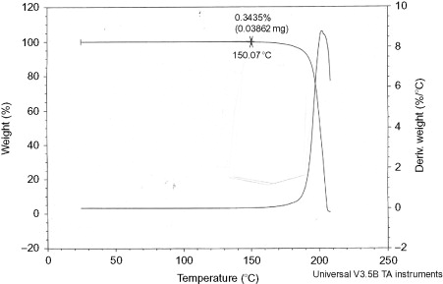
Tga thermograms
Two decomposition temp.
One decomposition temp.

Slide 10
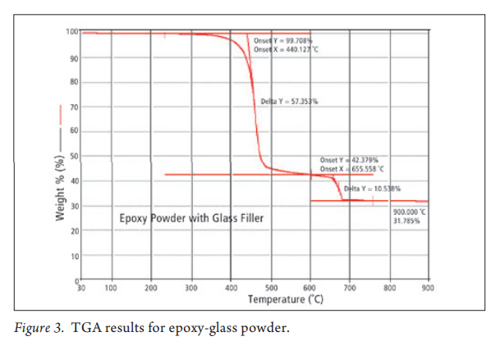
Tga analysis

Slide 11
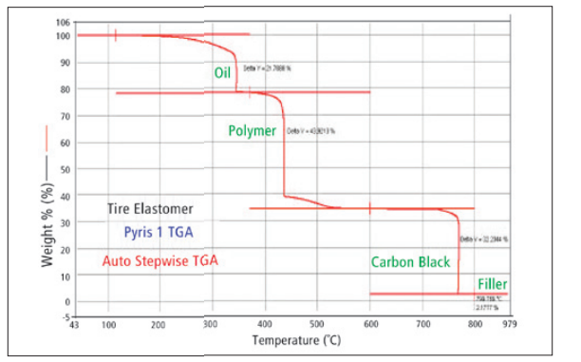
Tga-analysis
TGA Thermogram of elastomers

Slide 12
Tga-vidio

Slide 13
Tga-vidio

Slide 14
Tga-vidio

Slide 15
Thank you widad

